Slide 1
LECTURE 4 CARDINALITY OF SETS
CSC304
Stephen Lucci

Slide 2
Keywords to Live By
Alphabet
String
Concatenation
Binary Operation
Length of a String
Empty String, Identity, Substring
Prefix, Suffix, Proper Prefix, Proper Suffix
Subword, Kleene Closure
Positive Closure, Language
Language Expression, Palindrome
Problem Specification, Optimization Problem
Travelling Salesman Problem (TSP), Decision Problem
Language of a Problem

Slide 3
I Want the Punch Line First
This lesson deals with the cardinality of sets.
As a consequence of our discussion, we’ll find that there are more problems in Computer Science than there are algorithms.
Therefore, there must exist problems that are unsolvable.

Slide 4
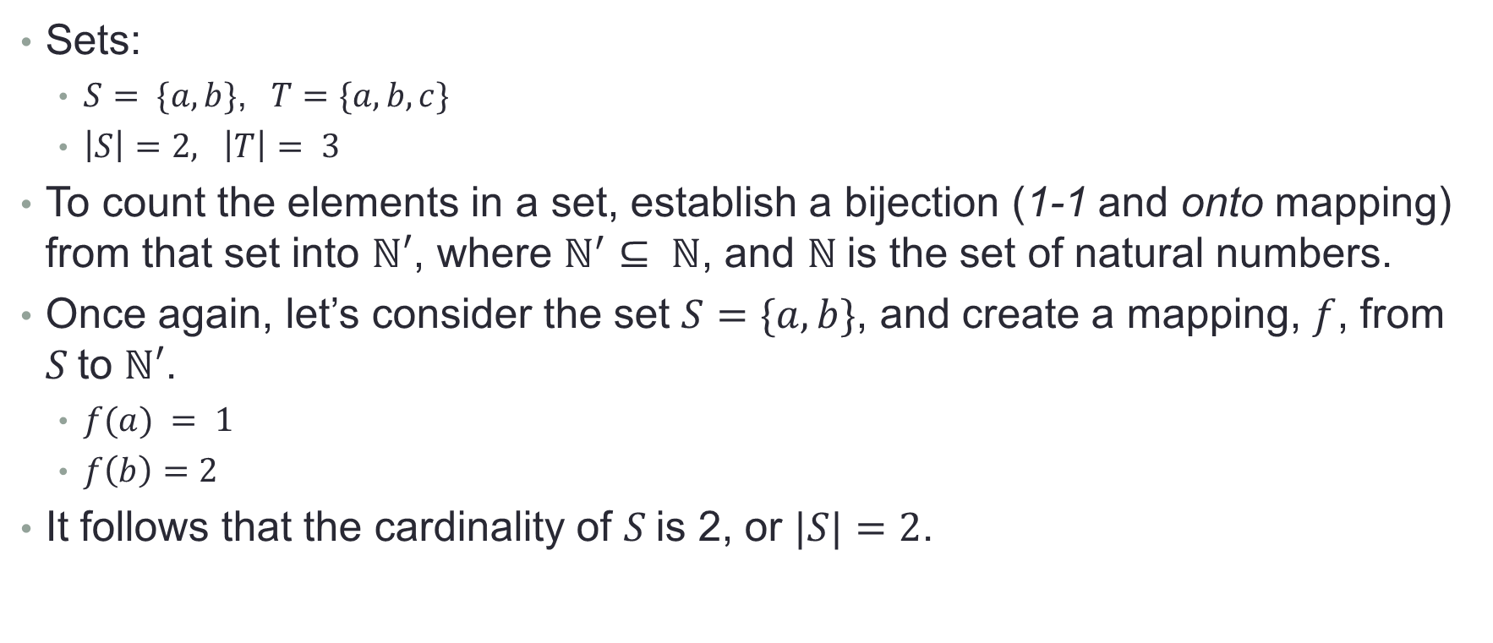
Counting (When it’s not a 4 Letter Word)

Slide 5
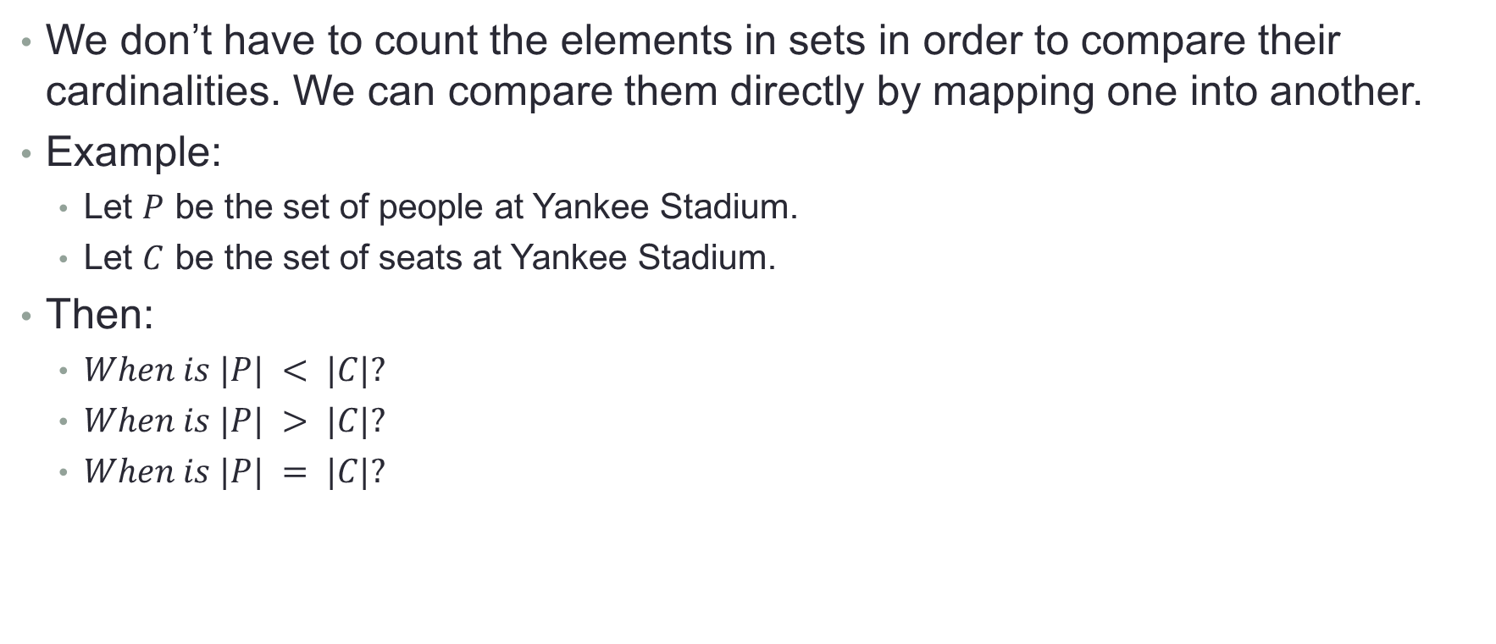
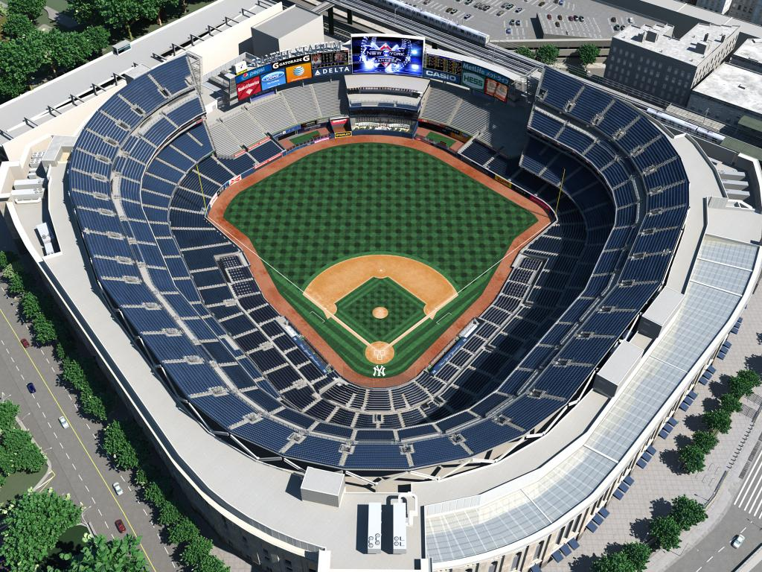
Comparing the Cardinality of Sets

Slide 6
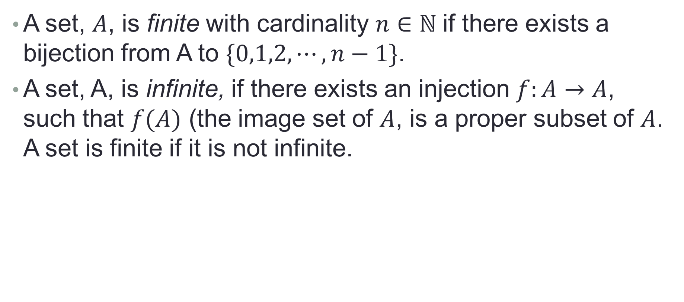
Finite and Infinite Sets

Slide 7
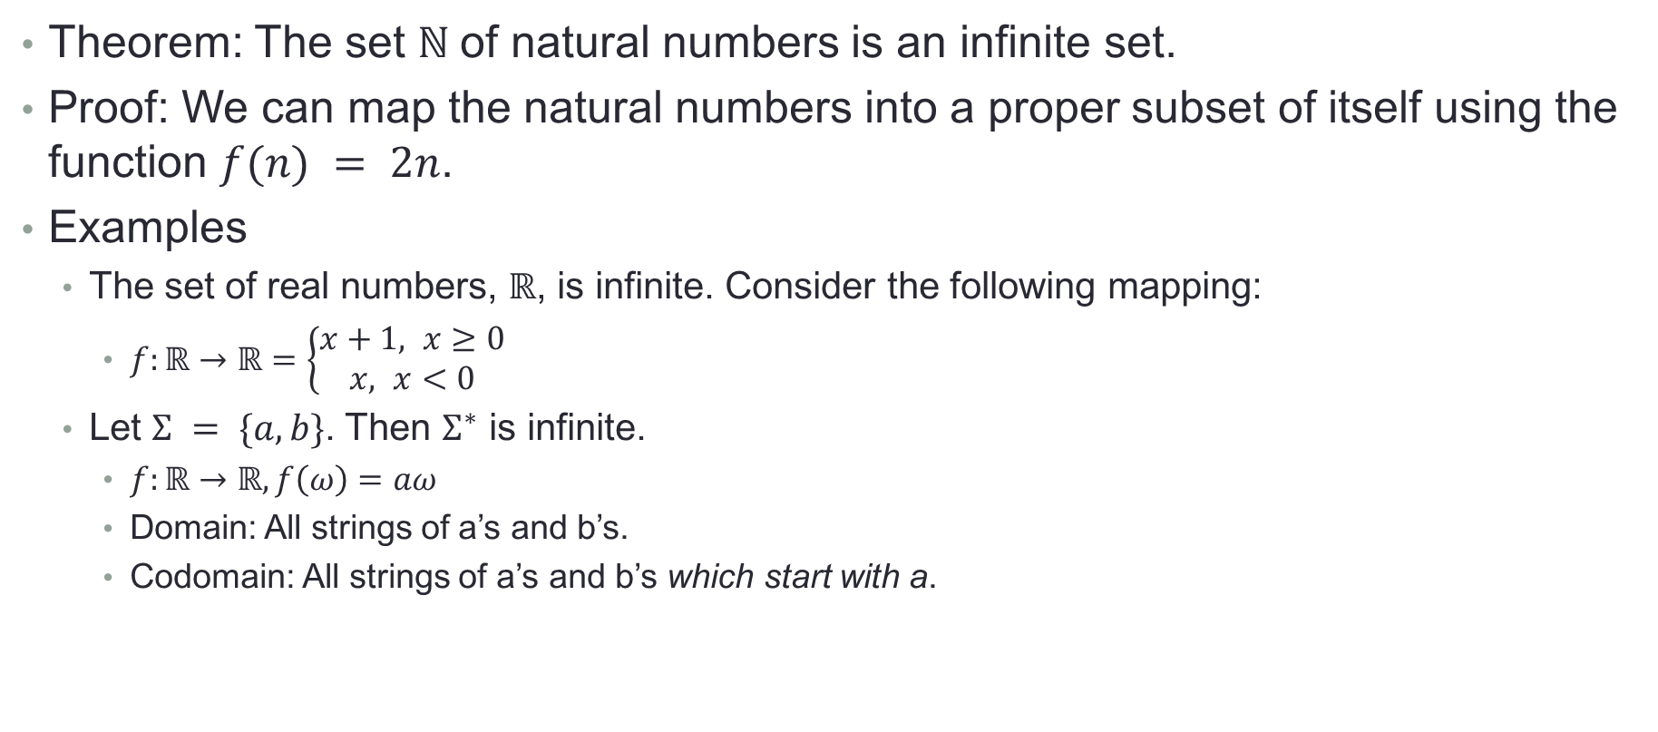
Finite and Infinite Sets

Slide 8
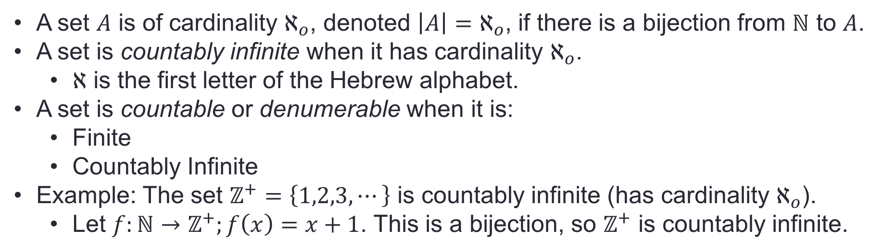
Finite and Infinite Sets

Slide 9
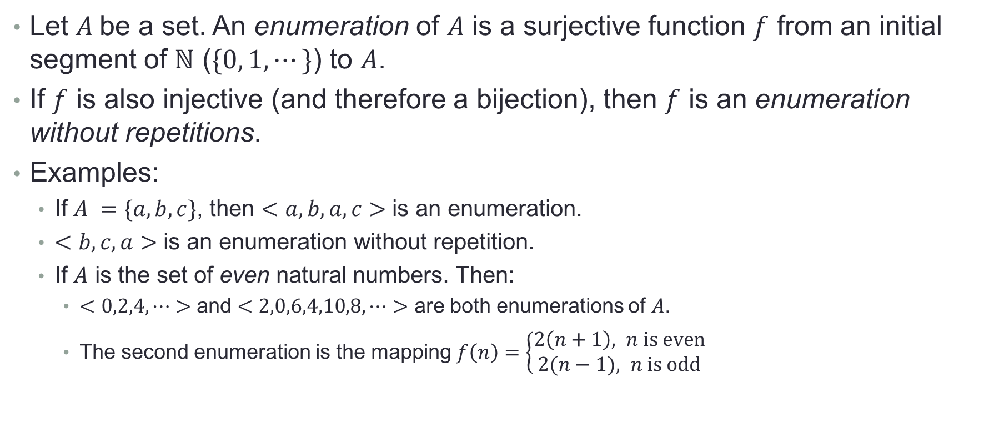
Countable and Uncountable Sets

Slide 10
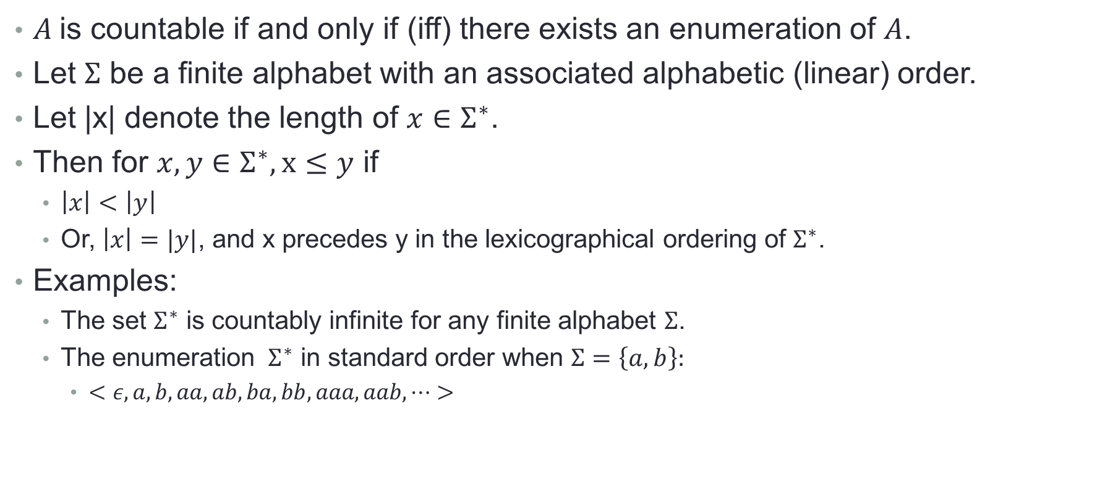
Countable and Uncountable Sets

Slide 11
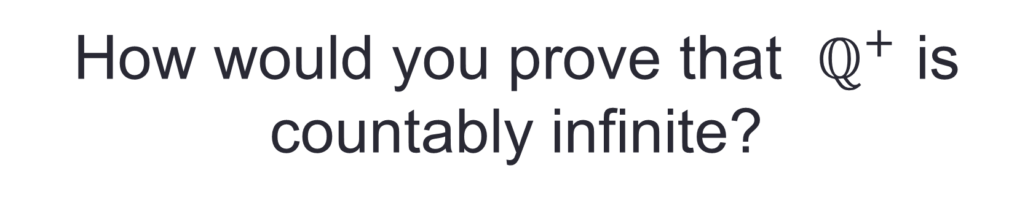
Cardinality of the Rationals

Slide 12
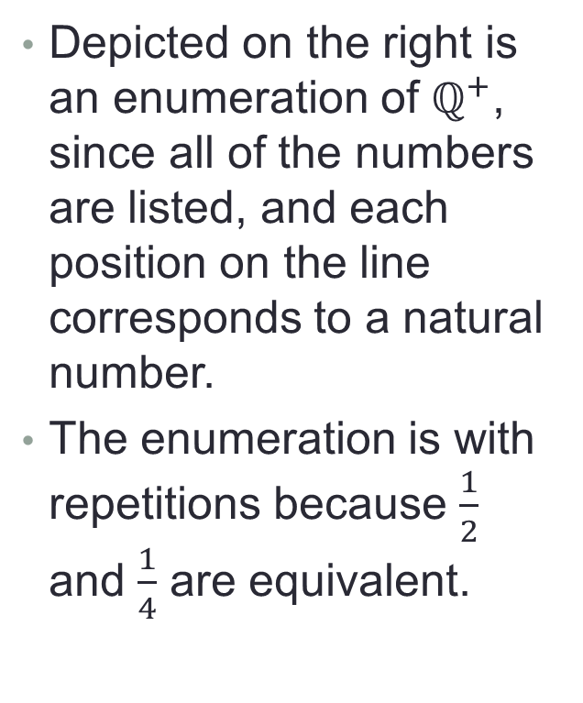
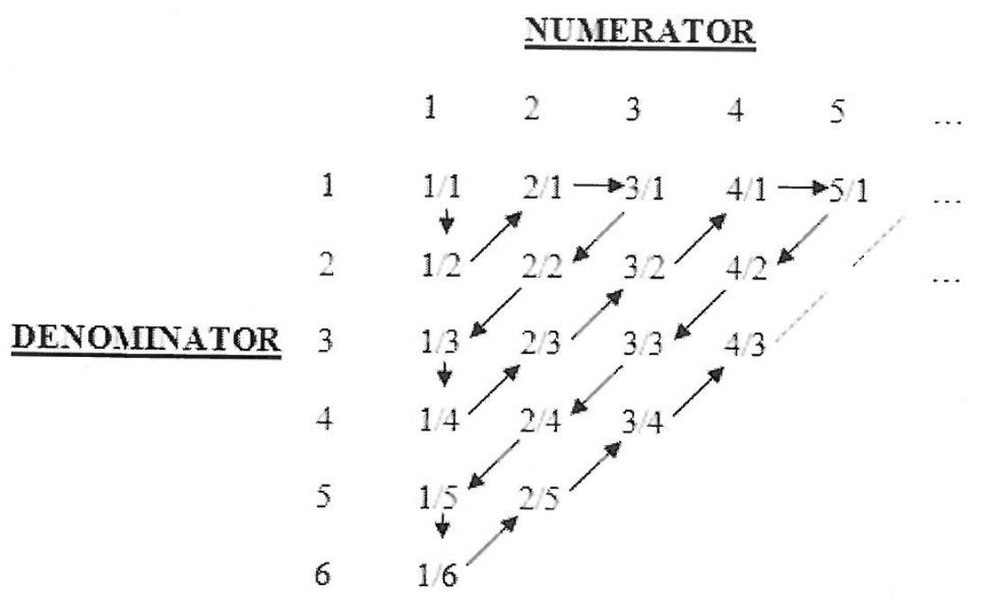
Cantor’s First Diagonalization Proof

Slide 13
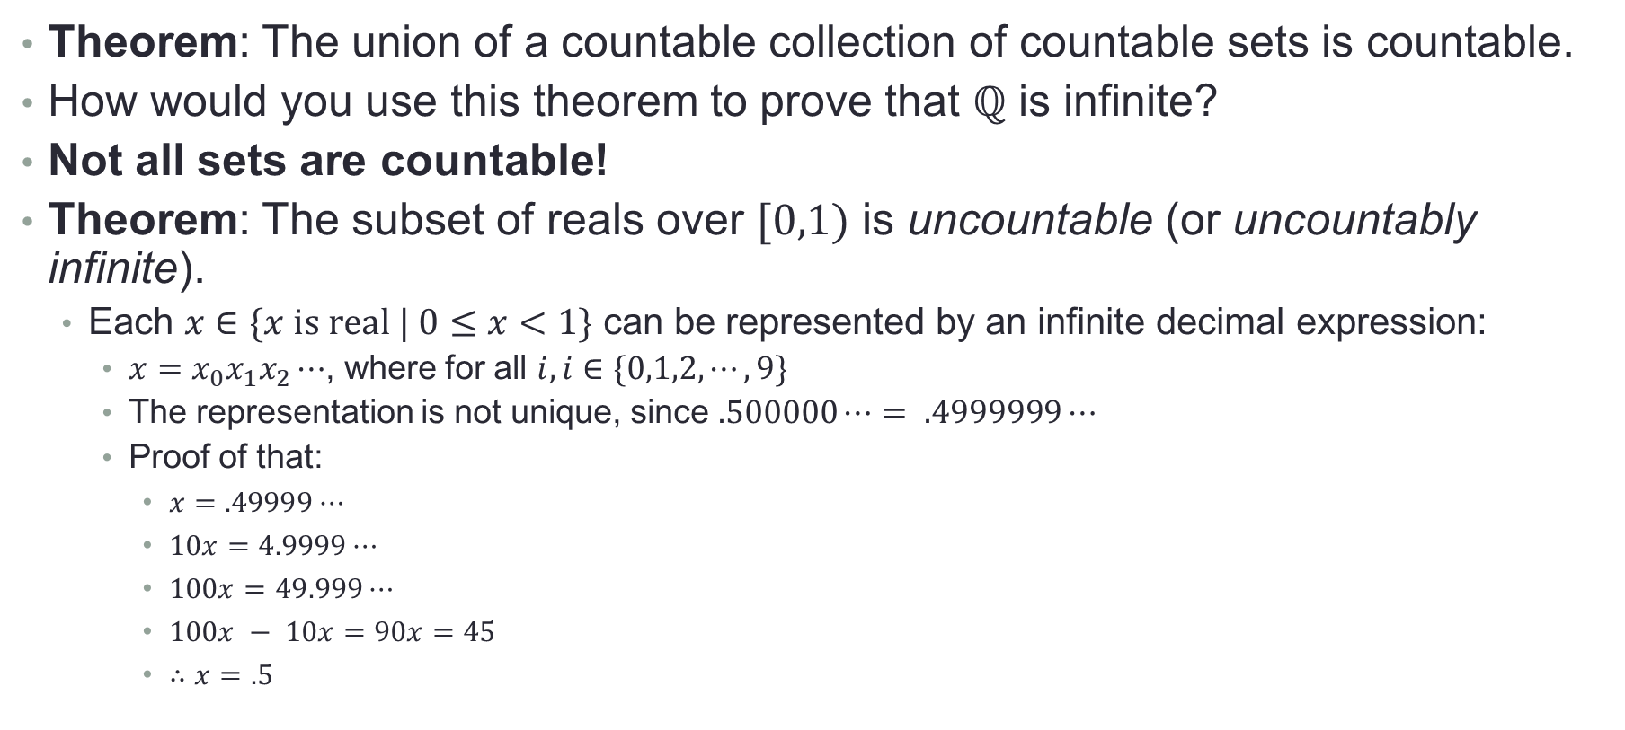
The Reals are Uncountably Infinite

Slide 14
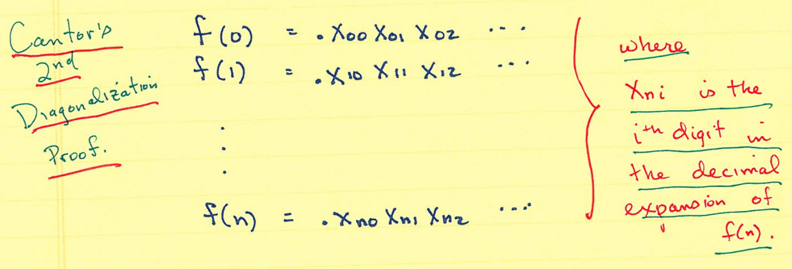
Cantor’s Second Diagonalization Proof
We’ll prove our statement using a Proof By Contradiction.
First, we assume that [0,1) is countable. Since it’s countable, there exists an enumeration for it. We’ll produce it.

Slide 15
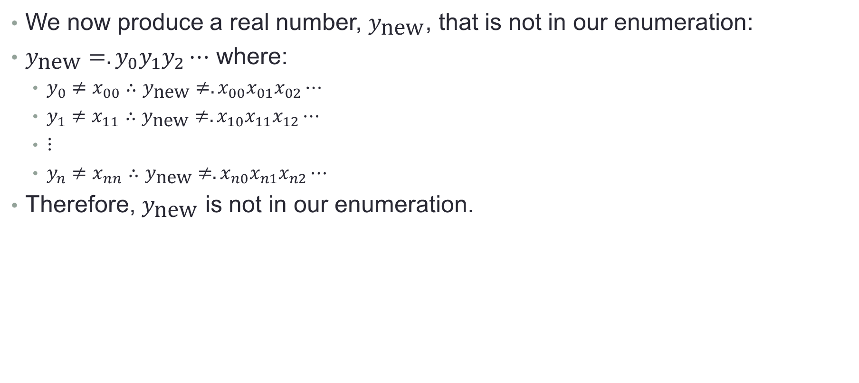
Cantor’s Second Diagonalization Proof

Slide 16
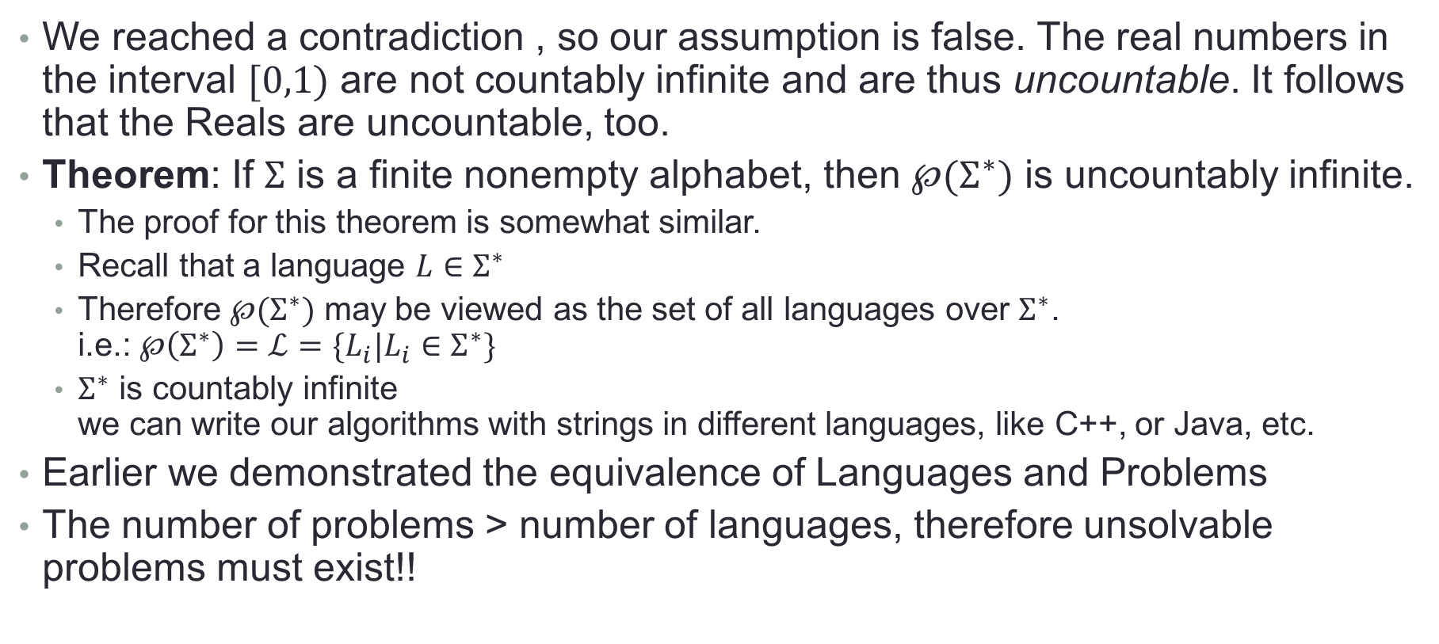
The Reals are Uncountable

